Slide 1
Dimensionality Reduction
Principal Component Analysis (PCA)
Linear Discriminant Analysis (LDA)
Kernel PCA
Quadratic Discriminant Analysis (QDA)

Slide 2
Principal Component Analysis (PCA)
Noise filtering
Visualization
Feature Extraction
Stock Market Predictions
Gene Data Analysis
GOAL
Identify patterns in data
Detect the correlation between variables

Slide 3
Principal Component Analysis (PCA)
https://plot.ly/ipython-notebooks/principal-component-analysis/
http://setosa.io/ev/principal-component-analysis/
Learn about the relationship between X and Y values
Find list of principal axes

Slide 4
Linear Discriminant Analysis (LDA)
Used as a dimensionality reduction technique
Used in the pre-processing step for pattern classification
Has the goal to project a dataset onto a lower-dimensional space
Sounds similar to PCA right ? - LDA differs because in addition to finding the component axises with LDA we are interested in the axes that maximize the separation between multiple classes.
Breaking it down further: - The goal of LDA is to project a feature space (a dataset n-dimensional samples) onto a small subspace k(where k<=n-1) while maintaining the class-discriminatory information. Both PCA and LDA are linear transformation techniques used for dimensional reductio. PCA is described as unsupervised but LDA is supervised because of the relation to the dependent variable.

Slide 5
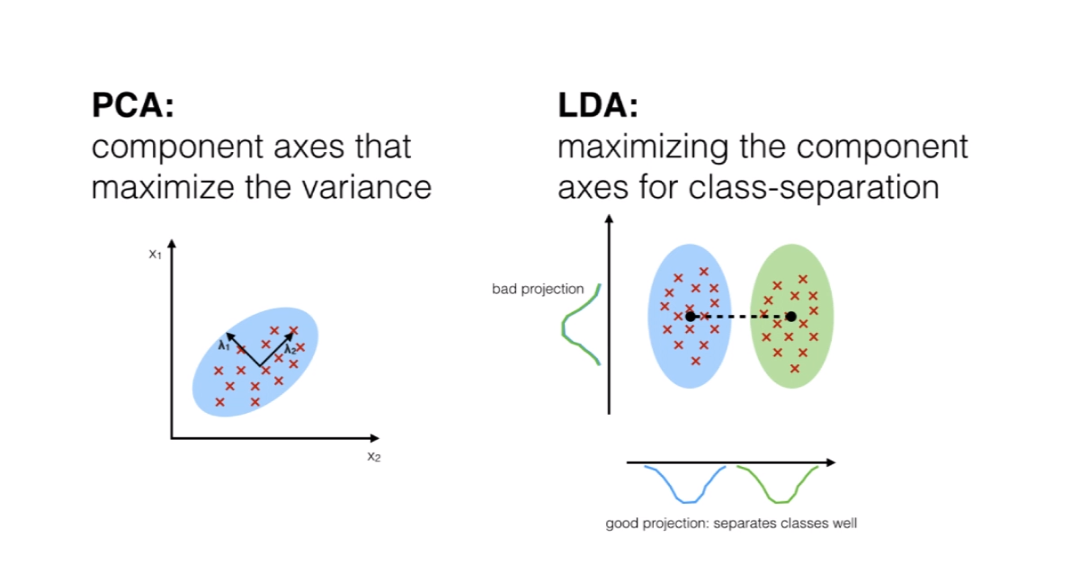
Linear Discriminant Analysis (LDA)
LDA - https://sebastianraschka.com/Articles/2014_python_lda.html

Slide 6
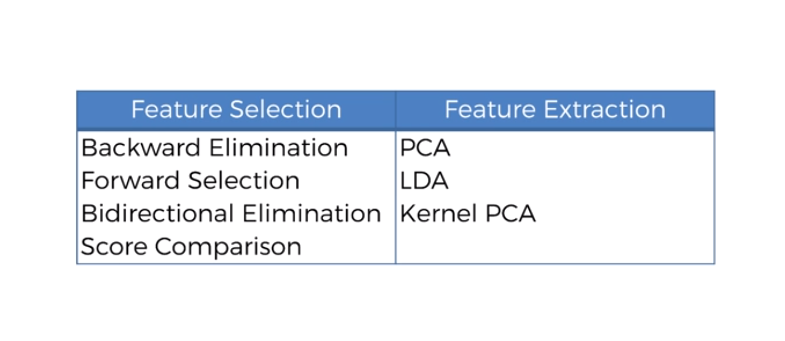
Dimensionality Reduction

Slide 7
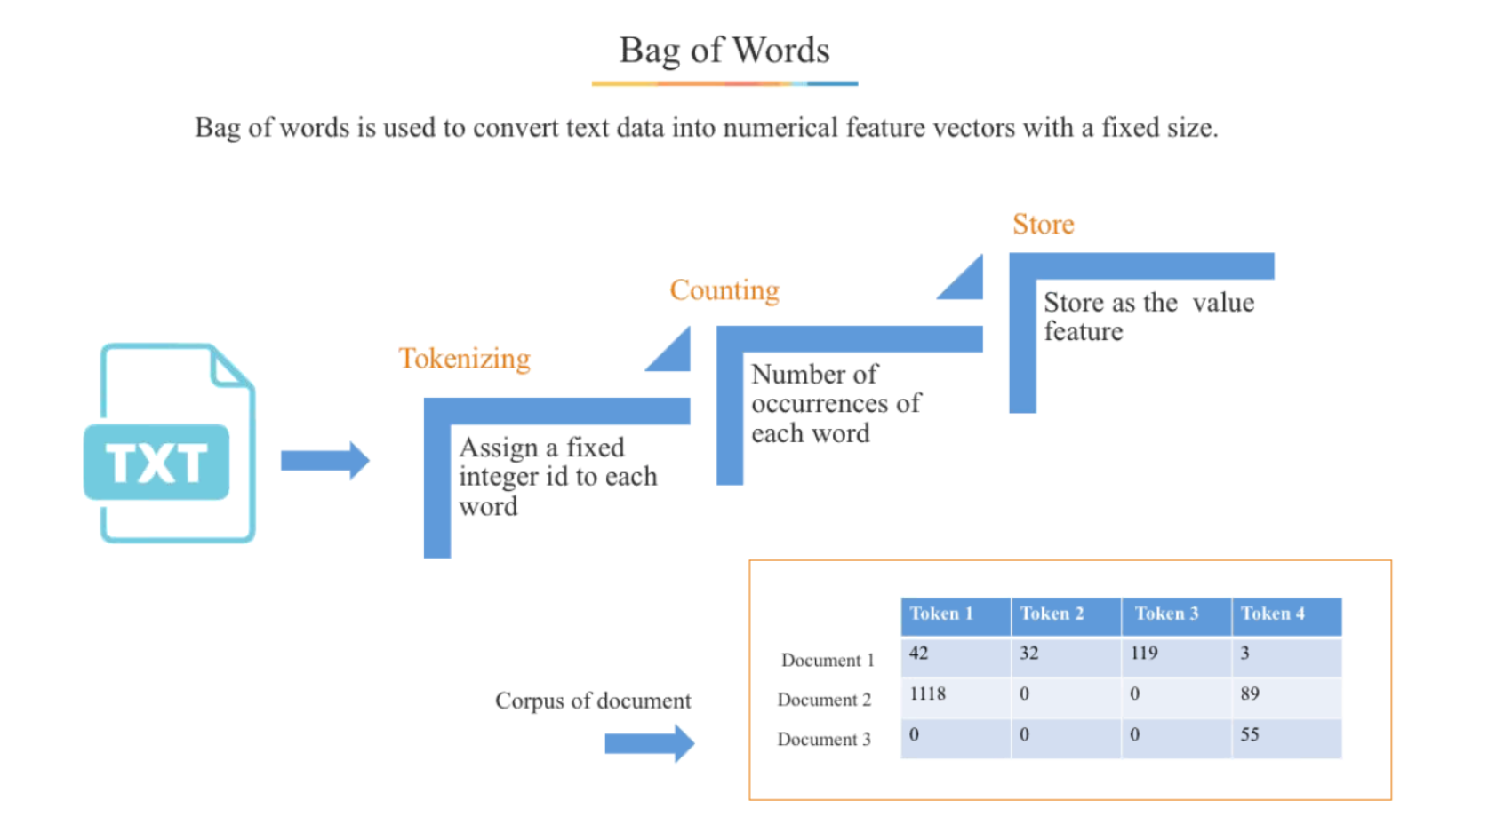
NLP

Slide 8
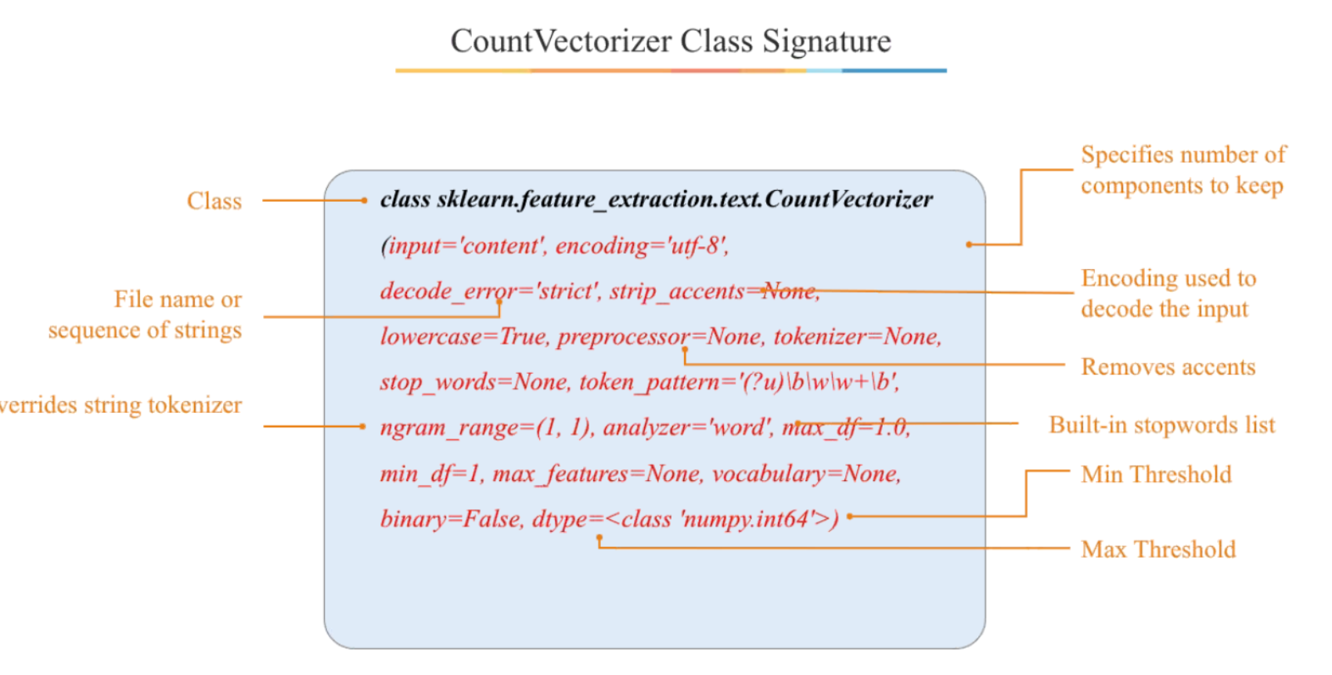
NLP

